Slide 2
Getting started with React
Speaker Name
Title
Speaker Name
Title
Notes:
Link to published module on Learn: https://docs.microsoft.com/en-us/learn/modules/learn-pr/language/react-get-started/

Slide 3
WELCOME EVERYONE!
Notes:
Welcome to Microsoft Learn Student Ambassadors Workshop. Today date <07-08-2022>

Slide 4
Leveraging VS Code Source Control for GIT and GitHub
Speaker’s Name
Notes:
The point of discussion for today is <Title> and I will be your host and facilitator

Slide 5
Who is this workshop for?
Everyone!
Notes:
Simple answer is that, this is for everyone beginner, intermediate and advance developer. VS Code is designed to run everywhere and for everyone as we will see in a bit. If you are running Windows, Linux or even MacOS, if you are a web developer, ML/AI engineer, Data Science (Jupyter Notebook), Android developer and even content writers.

Slide 6
Prerequisites
Installed Git
Installed Visual Studio Code
Have an active GitHub account
Notes:
The simple requisite is having all this running on our computer. We will not spend time going through the process of doing all this. I will be adding a link to do all this at the end of this presentation. Follow along, you will still learn a lot.

Slide 7
Learning objectives
Understands VS Code Interface
Perform basic Git tasks
Initialize
branch actions
Stages
remote
Notes:
I will be showing us around VS Code interface very briefly before we deep dive into performing various Git task using the power of VS Code.

Slide 8
Leveraging VS Code Source Control for GIT and GitHub
Notes:
Let’s dive deep into leveraging the power of VS Code to perform Git and GitHub tasks.

Slide 9
Congratulations to those who hates memorising commands ):
Notes:
Many beginners find it very difficult memorizing commands. While many enjoy memorizing it but the fact that they are required to execute the commands in orders is another tedious and most difficult things for many newbies and even advance users. VS Code team cover us with a built in tools that helps us eliminate the process of memorizing commands and at the same time fast and easy to use.

Slide 10
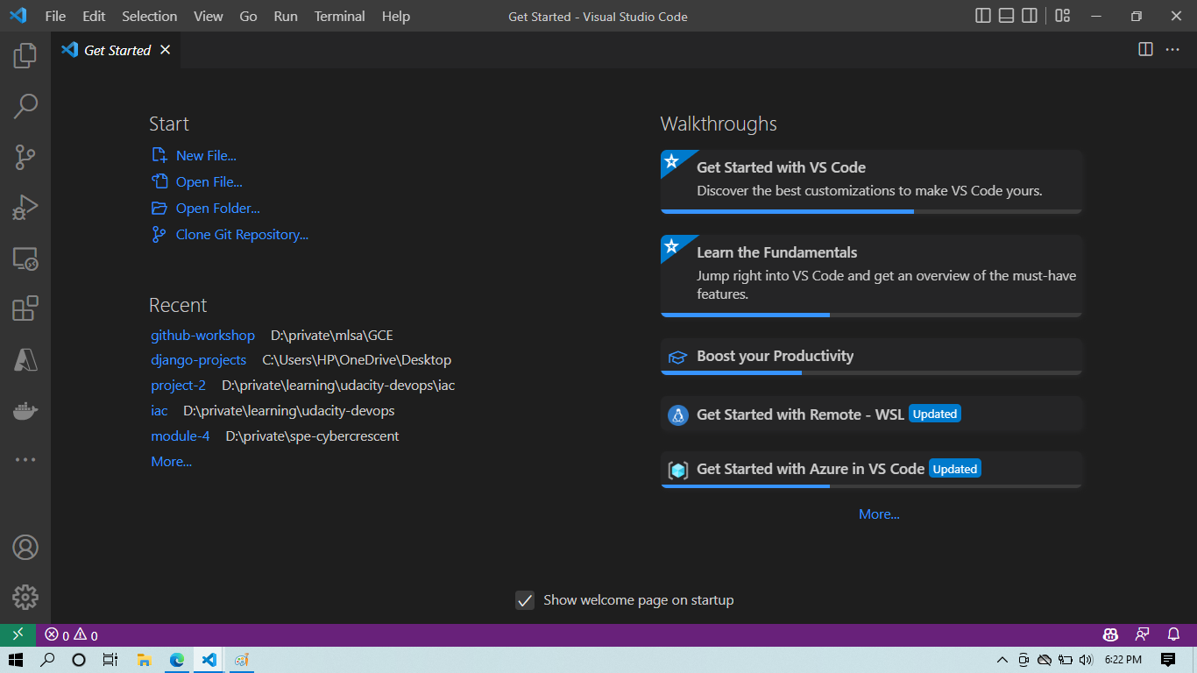
What is VS Code?
Code editing.
Redefined.
Free.
Built on open source.
Runs everywhere.
Notes:
The picture at the right hand side is the VS Code at launch! According to the VS Code official page, VS Code is a free tool that is use to edit codes, refactor codes, it is open source and multi-platform. Which means it runs on Windows, Linux and MacOS. It is free because you don’t have to pay a dime to start using VS Code. Visit the official page, download and start using it to do magic.

Slide 11
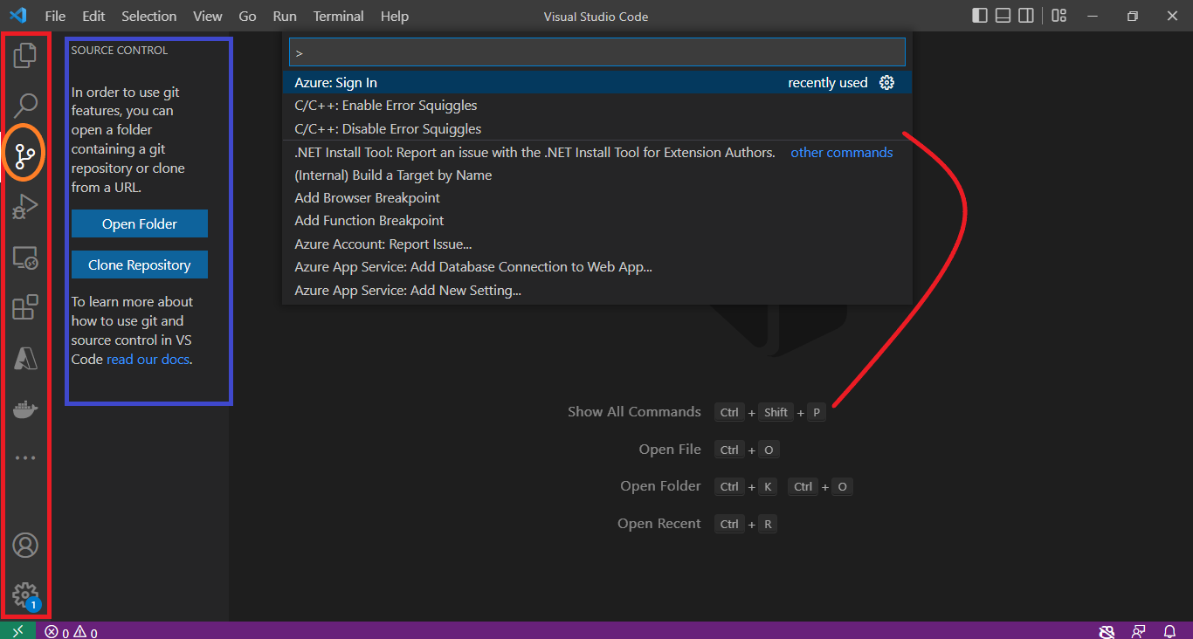
Overview
Notes:
At this point, it is important to streamline and our learning process. There are key features that needs our attentions right now.
Sidebar (red rectangle): At the sidebar is where the source control tab live.
Source Control Tab (Orange circle) and its extension (blue region)
Command Pallette (red curve). The curve connect the command to open the pallets. Go to view to open it without the command.

Slide 12
Exercise
Open any empty folder in VS Code
Click the source control tab
Click Initialize repository
Notes:
This folder will be house of everything for this workshop. By clicking the initialize repository. This will gives git ability to track our project by creating .git file inside the current working directory.

Slide 13
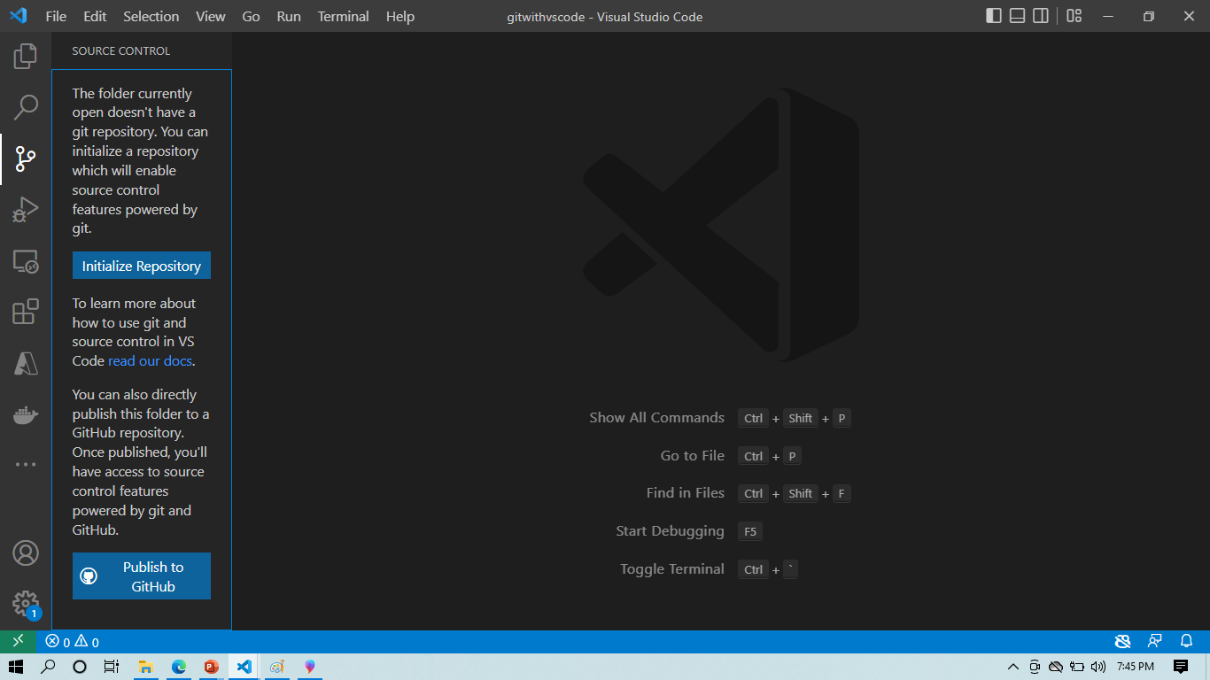
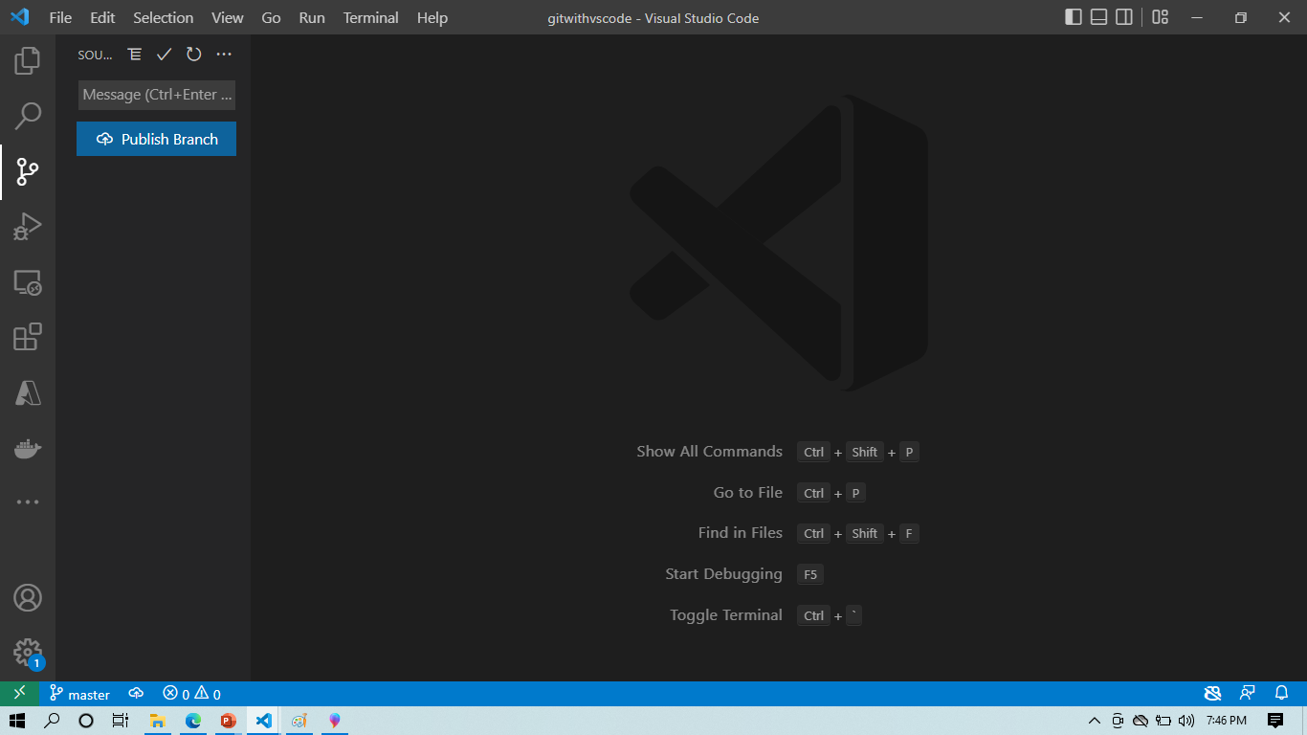
Solution
1
2
Notes:
After opening the empty folder. Clicking the 1 will open up the extension to click the 2 and boom finally gives the expected result if git initially install correctly. Notice the yellow rectangle at the right hand side. It shows the branch created by default for us by git.

Slide 14
Branch
A branch is a new/separate version of the main repository.
Notes:
a branch is a new/separate version of the main repository.

Slide 15
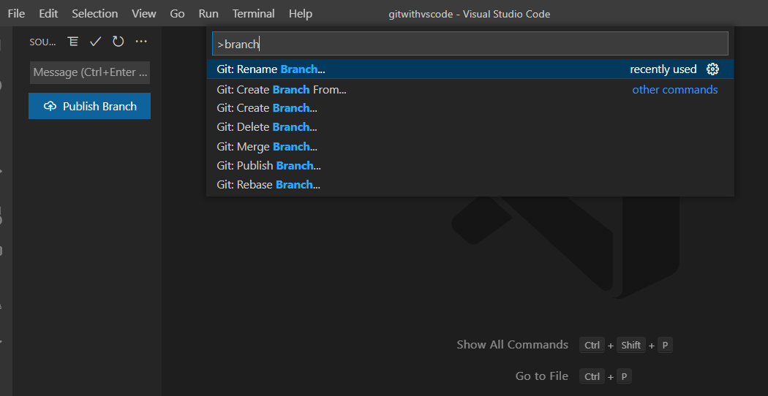
Branch Actions
Rename
New/Create
Switch
Delete
Merge
Notes:
Basically, this is to discuss what the actions we can perform on the branches of the repository. Press CTRL + SHIFT + P then type branch into the command palette to see all the actions that can be performed on the branch. Or otherwise use the button in the red tag to carry out all the actions.

Slide 16
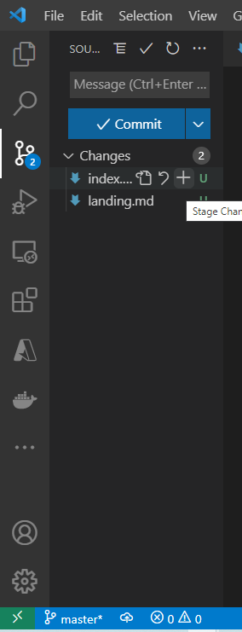
Stages
Add: It adds file contents to the index(staging). This is the temporary addition of the contents into the staging environment
Notes:
Red circle is to stage the code edited (it is the process of adding it to the index head temporarily). It adds file contents to the index(staging). This is the temporary addition of the contents into the staging environment. This command updates the index using the current content found in the working tree, to prepare the content staged for the next commit

Slide 17
Stages
Commit: This record changes permanently to the repository.
Notes:
The yellow box is to commit and add it permanently to the head. This required a commit message which is description of what is being added to source code. This record changes permanently to the repository.

Slide 18
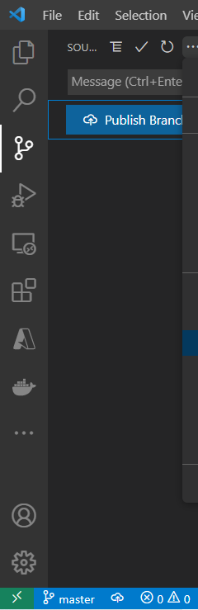
Stages
Remote/Publish: This manage set of tracked repositories. Manage the set of repositories (“remotes”) whose branches you track.
Notes:
This manage set of tracked repositories. Manage the set of repositories (“remotes”) whose branches you track.

Slide 19
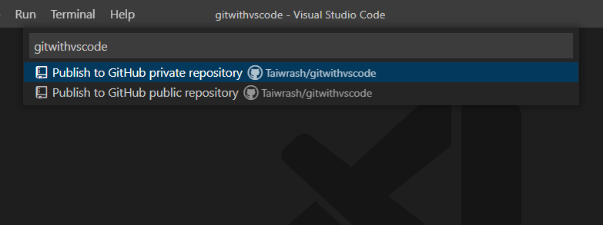
Stages
Public /Private: Public repositories are accessible to everyone on the internet. Private repositories are only accessible to you, people you explicitly share access with
Notes:
Probably for organization repositories, certain organization members. Organization owners always have access to every repository created in an organization.

Slide 20
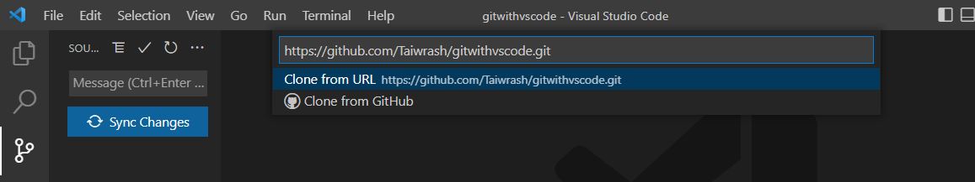
Stages
Clone: This clones a repository into a newly created directory
Notes:
It creates remote-tracking branches for each branch in the cloned repository (visible using git branch –remotes), and creates and checks out an initial branch that is forked from the cloned repository’s currently active branch.

Slide 21
Demo
Rasheed Mudasiru
Notes:
Let’s demonstrate all this tasks in VS Code!

Slide 22
Knowledge Checks
Never try a question more than once
Notes:
This is your time to win your swags. I will be creating an answer sheet in the chat section and all answers within the start and end of the answer sheet will be considered. The team will be reaching out to the winners with their prizes.
Never try a question more than once

Slide 23
What is the correct command to open the command palette?
A. CTRL + S + P
B. CTRL + ALT + P
C. CTRL + P
D. CTRL + SHIFT + P
E. None of the above

Slide 24
What is the correct command to open the command palette?
A. CTRL + S + P
B. CTRL + ALT + P
C. CTRL + P
D. CTRL + SHIFT + P
E. None of the above

Slide 25
Which of the following action of git requires a message?
A. Add/stage
B. Push
C. Commit
E. None of the above

Slide 26
Which of the following action of git requires a message?
A. Add/stage
B. Push
C. Commit
E. None of the above

Slide 27
Which of the following is not required to use Git in VS Code?
A. Python
B. Git
C. VS Code
E. None of the above

Slide 28
Which of the following is not required to use Git in VS Code?
A. Python
B. Git
C. VS Code
E. None of the above

Slide 29
Summary
You can perform all Git tasks all within your VS Code without executing a single Git commands by just leveraging the power of VS Code.

Slide 30
Next Steps
VS Code official documentation on source control feature
A quick start created for everyone
VS Code Source Control Basics Video
Git
GitHub

Slide 31
Shout Out!
Share on social media with hash tags #MSFTAmbassadors, <any other hashtag> and tag @microsoftlearn
Please tell us how you liked this workshop by filling out this survey:
https://aka.ms/workshopomatic-feedback
Notes:
Add any other handles and hash tags here

